Slide 1
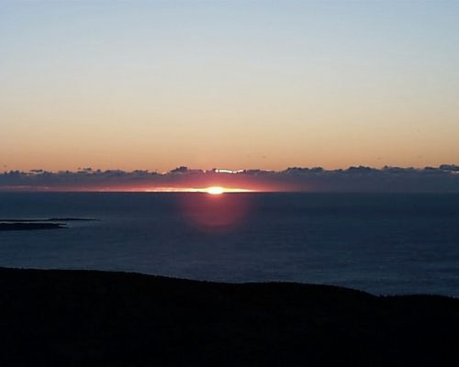




Genomic Biomarker Signatures of Circadian Time and Traumatic Brain Injury DARPA Deep Purple Hackathon
Ravi Allada, M.D.
Professor, Depts. of Neurobiology and Pathology
Associate Director, Center for Sleep and Circadian Biology
Northwestern University

Slide 2
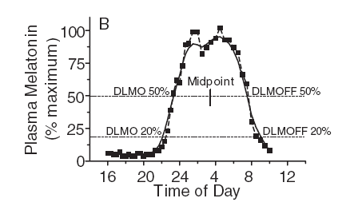
Current Methods for Assessing Circadian Phase for Diagnostics Require Serial Sampling
Notes:
Current gold standard

Slide 3
Time Stamp: Assessing Temporal Organization in a Sample to Diagnose Circadian Disruption
Temporal Profiling
Morning
Computational quantitation of temporal organization from a single sample
Temporal
Genome Expression Signature
Diagnostic
Prognostic
Chronotherapy
Gene Expression
Evening
Applied to any “-omics”, e.g., metabolomics, to human samples, e.g., blood
Genes Ordered by Peak Time of Expression
Ueda et al., 2005, Allada, Braun, Zee, and colleagues, unpublished
Notes:
The need to measure

Slide 4
Circadian Changes as Etiology of Insomnia Symptoms in Traumatic Brain Injury
Sleep disturbance following mild TBI may be associated with alterations in the timing and rhythms of sleep
36% of patients with complaints of insomnia following mild TBI were diagnosed with circadian rhythms sleep disorders (CRSD)
Two types of disorders were observed (with unique melatonin and body temperature rhythms):
Delayed sleep phase syndrome (DSPS)
Irregular sleep-wake pattern (ISWP)

Slide 5
Temporal Analysis of Samples from Human Subjects
Healthy/Normal Chronotype
TBI: Normal v. Abnormal Chronotype
Controlled Sleep Lab (NU) every 2 h
Low Frequency (4x/12 h)
Low Frequency
1 mo., 2 mo, 6 mo
Blood Transcriptome/Plasma Melatonin
Establish Baseline
Time Stamp
Is Time Stamp Diagnostic/Prognostic?
Recovery Time for TBI

Slide 6
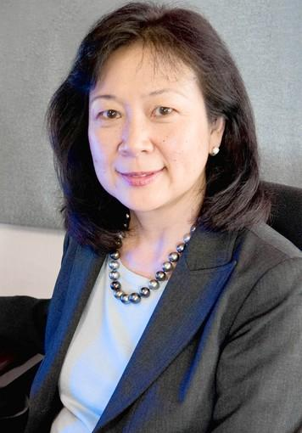

Human Time Stamp – Protocol
Phone/Online Screening
Basic demographic information
In Person Screening
Screening questionnaires
History and Physical
7 days
Actigraphy/Sleep Log
Reid
Zee
Abbott
7 days
Actigraphy/Sleep Logs and DLMO
DLMO – Dim light melatonin onset
3 days
28 hour profile
Frequent (Q2hr) sampling to create ‘Time Stamp’
7 days
Actigraphy/Sleep Logs
Limited (4 sample) profile
Validation of Time Stamp with
limited (4 sample) testing
2 days

Slide 7
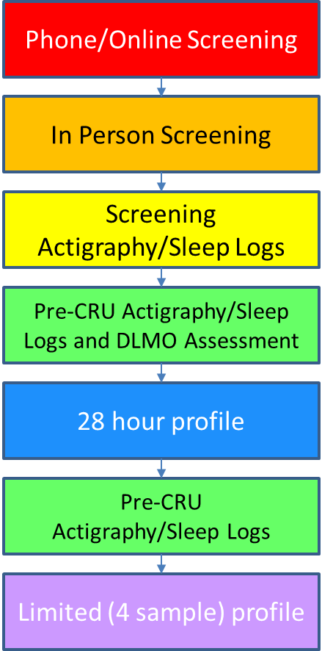
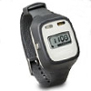
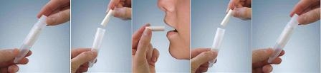
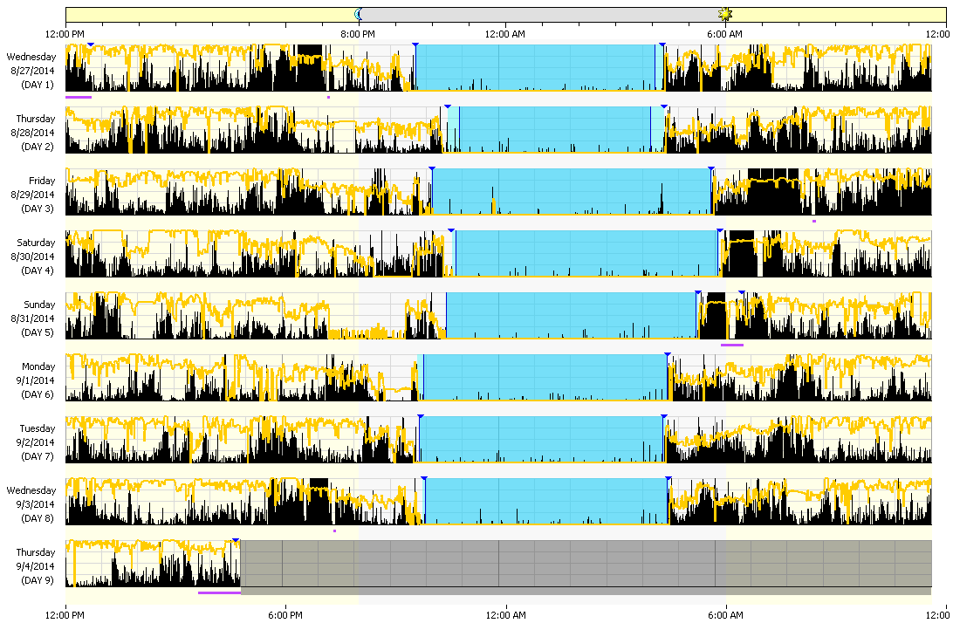
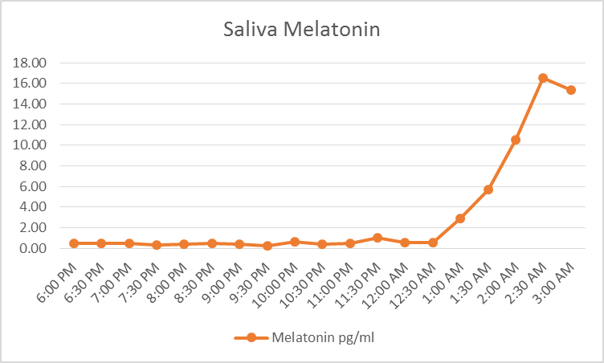
Time Stamp in Healthy Adults-Screening
Healthy adults, normal sleep quality and duration
Actigraphy
Salivary DLMO

Slide 8
Validating a Time Stamp in Healthy Adults: Laboratory Conditions and Blood Sampling
Constant Routine:
Dim light
Isocaloric snacks
Semi-recumbent position
Dinner
Admit
Habitual Bedtime
Day 1
Sleep
Day 2
Habitual Bedtime
Discharge
Day 2
Sleep
Day 3
28hr blood
sampling
12
14
16
18
20
22
24
02
04
06
08
10
12
PSG
Clock time (hours)
28 hour blood sampling:
Q1hr Melatonin and Cortisol
Q2hr Whole blood (RNAseq), Cytokines and Comprehensive metabolic panel*
*(Albumin, Alkaline phosphatase, ALT (alanine aminotransferase), AST (aspartate aminotransferase), BUN (blood urea nitrogen), Calcium, Chloride, CO2 (carbon dioxide), Creatinine, Glucose, Potassium, Sodium, Total bilirubin, Total protein)
PSG
Notes:
Discuss constant routine.

Slide 9
Subjects / Visits
12 healthy controls
One visit, two sampling protocols
High-frequency / extended sampling: draws every 2h over 28h
Low-frequency / limited sampling: draws every 4h over 12h
21 TBI subjects
Three visits: t=0, t=2mos, t=6mos after recruitment
Low-frequency / limited sampling at each visit
Visit completion: 20/21 have RNAseq data for visit 1; 11/21 have RNAseq data for visit 2; 5/21 have RNAseq data for visit 3.

Slide 10
Recruitment criteria
Control Inclusion criteria:
intermediate circadian chronotype (Munich Chronotype Questionnaire)
medically stable;
between the ages of 18 – 60 years;
able to follow directions.
Control Exclusion criteria:
history or current DSM-IV major psychiatric disorder;
use of psychoactive medications;
Beck Depression inventory >16, indicating possible depression;
a history or current diagnosis of a primary sleep disorder
shift work or other types of self imposed irregular sleep/wake cycles;
history of, or concurrent, unstable or serious medical illness.
TBI criteria:
Mild-moderate TBI
Notes:
DSM-IV: Diagnostic and Statistical Manual of Mental Disorders, 4th. Edition

Slide 11
Biomarkers assayed (TBI and Controls)
Plasma melatonin
Salivary melatonin
Plasma cortisol
Comprehensive metabolic panel:
Sodium, potassium, chloride, CO2, creatinine, glucose, etc.
16 markers in total
Whole blood gene expression (RNAseq)
Raw data (fastq)
Metadata for each file

Slide 12
Additional covariates (TBI and Controls)
Initial visit questionnaire scores (18 total):
Becks Depression Index
Epworth Sleepiness Scale score
Horne-Ostberg score (morning/evening)
6 MCTQ scores (Munich Chronotype Questionnaire)
8 PSQI scores (Pittsburgh Sleep Quality Index)
STOP-Bang questionnaire score
(Snoring – Tired – Observed – Pressure – BMI – Age – Neck size – Gender)
Notes:
Sleep Apnea STOP-Bang: Snoring –Tired – Observed – Pressure – BMI - Age>50-Neck size large - Gender

Slide 13
Additional covariates (Controls ONLY)
Actigraphy data
Summary values: sleep start, sleep end, mid-sleep time
Psychomotor vigilance task
10 sessions
Summary values: number of trials/session and number of false starts; average of top 5%, top 10% fastest and slowest trials; mean, median, 90th percentile, 95th percentile
VAS - subjective ratings
8 rating scores: sleepy, alert, sad, tense, effort, happy, weary, calm
Every 2h starting 1h after wake until 15h after wake
NB: TBI (case) data is still in process
Notes:
VAS - Visual Analogue Scale

Slide 14
Data Overview
Three directories:
Case-TBI/ = TBI data (non RNA-seq)
Control/ = control data (non RNA-seq)
RNAseq/ = RNAseq data for both TBI and control
All data in CSV / FastQ format
Data in various files can be linked with via subject ID’s XXXX-XXX
README.txt file also describes contents of the data directories

Slide 15
Data Organization – non-RNAseq Data
Data for questionnaires, melatonin, cortisol, CMP, and actigraphy/VAS/PVT (where available) organized by group (TBI/control)
.csv row=subject (subject ID XXXX-XXX), column=covariate
Case-TBI/ :
TBI_Compiled_Data_MG20171005.xlsx = original human-readable data
TBI*.csv = machine-readable .csv file derived from .xls sheets
TBI_Data_Dictionary.csv = mapping of column names to covariate descriptions
Control/ :
Controls_Compiled_Data_MG20171005.xlsx = original human-readable data
Controls*.csv = machine-readable .csv file derived from .xls sheets
Control_Data_Dictionary.csv = mapping of column names to descriptions
Notes:
VAS - Visual Analogue Scale
PVT - Psychomotor Vigilance Test
CMP - Comprehensive Metabolic Panel

Slide 16
Data Organization – RNAseq Data
RNAseq/ :
reads/ = subdirectory containing FastQ files, organized by sampleID (NU.xxxx)
RNAseq-metadata-time_randomized.csv = metadata for each NU.xxxx sample: - Subject ID (XXXX_XXX) - High / low frequency sampling protocol (HFWB/LFWB) - Visit # - TBI / control

Slide 17
Hackathon Challenge
NOTE regarding time blinding & randomization:
Times are NOT included as part of metadata
Samples are NOT time-ordered; i.e., consecutive files / rows in the metadata do not correspond to consecutive time-points
Public data (eg GSE39445) may be used as a training set to infer sample times
Challenges:
Determine the real time of samples (ideally from a single sample)
Build a classifier differentiating Control from TBI subjects (control for chronotype)
Can you detect lesser distinguishable features or diminishing effects over time in TBI subjects

Slide 18
TimeStamp is More Accurate (Using Fewer Genes) than Other Time Estimating Algorithms
PL=Partial Least Squares Regression (Liang, et al., 2017)
ZZ= Zeitzeger (Hughey et al., 2016)

Slide 19
2-sample TimeStamp predictions

Slide 20
Summary
Rapid/simple assessment of new samples
Application to new data is simple & direct (no need for co-normalization, batch correction, or re-training the predictor)
Incorporate a wide range of sample types
Predictor is independent of protocol and platform
Highly accurate
Mean Absolute Error < 2h)
Prediction requires assaying only 40 genes
no genome-wide Z-scoring required

Slide 21
Hackathon Challenge
NOTE regarding time blinding & randomization:
Times are NOT included as part of metadata
Samples are NOT time-ordered; i.e., consecutive files / rows in the metadata do not correspond to consecutive time-points
Public data (eg GSE39445) may be used as a training set to infer sample times
Challenges:
Determine the real time of samples
Build a classifier differentiating Control from TBI subjects
Can you detect lesser distinguishable features or diminishing effects over time in TBI subjects

Slide 22
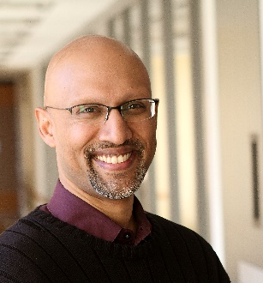
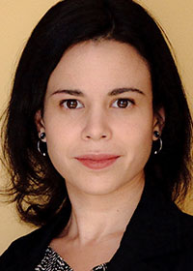
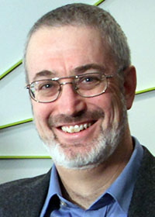
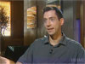

Human Time Stamp Team
Ravi Allada
RNA-seq
Sample Coordination
Phyllis Zee
Kathy Reid
Human subject recruiting, screening and CRU sampling
Rosemary Braun
William Kath
RNA-seq/Time Stamp analysis
Jordan Grafman
TBI subject recruiting, screening, and clinical analysis
Grant Barish
Library generation and RNA sequencing
Notes:
Add photos

